Slide 1
Standards and Patents in the CEN and CENELEC system
Enabling the engagement of industry and stakeholders

Slide 2
Summary
The CEN and CENELEC system
Standards and Patents
CEN and CENELEC Patent policy
Patent Holder vs Standard users?
CEN-CENELEC approach towards ADR
Patents an issue for the future?

Slide 3



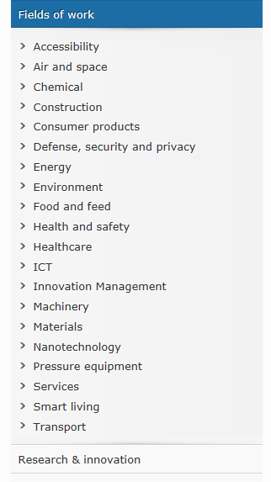
~500 TCs
450 CEN - 50 CENELEC
~2.000 WGs
Electric Vehicles
Electromagnetic Compatibility
Fibre optic Communications
Fuel Cells
Household appliances
ICT
Interoperability
Medical Equipment
Railways
Smart grids
SmartHouse
Smart metering

Slide 4

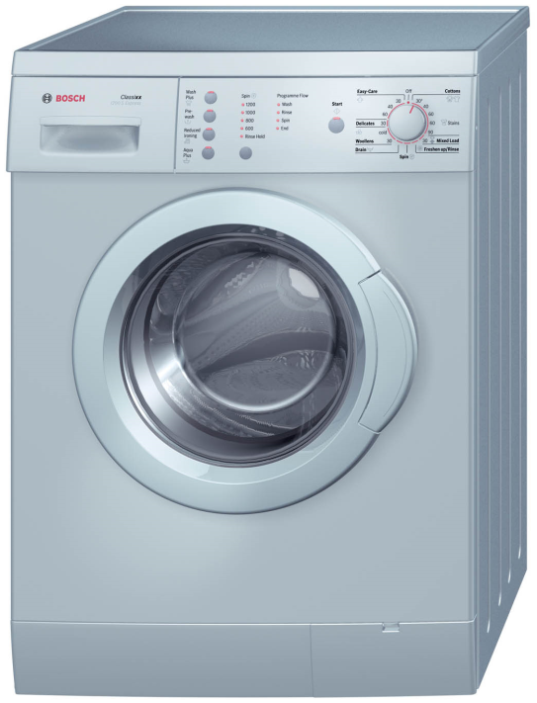
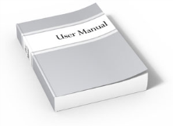
Standards and Patents
A practical example...
Registered Company Name: Robert Bosch GmbH
Commercial Name: BOSCH
Domain Name: www.bosch-industrial.com
Trademarks
Design: body
Patent: engine and drum
Copyright:
User manual
and ~15 ENs!
Notes:
.

Slide 5
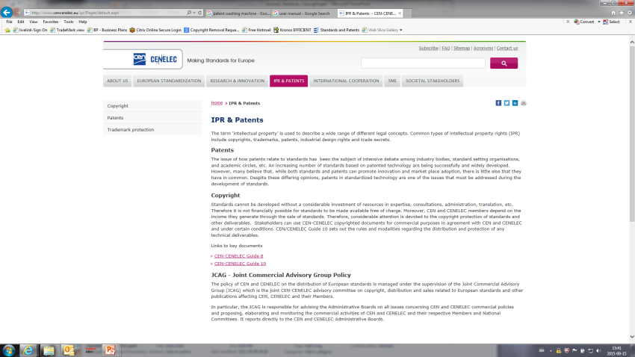
CEN-CENELEC and SEPs
CEN-CENELEC Guide 8
“Guidelines for implementation of the common IPR policy on Patent”
Available on the CEN and CENELEC websites

Slide 6
CEN-CENELEC Patent policy
CEN-CENELEC Guide 8 on Implementation of the Common Policy on Patents
Based on ISO/IEC/ITU common patent policy
Voluntary early declarations “at the best of experts’ knowledge”
Essentiality
Examine relevance of declared patents, but NOT scope, validity & terms
FRAND conditions (Fair, Reasonable And Non Discriminatory)

Slide 7
What patents are included in the standard?
A- Patents that are essential for the standard
when it is not possible, according to the patent holder at the time of the standardization making process, to make a product/method according to the standard without infringing the patent holder’s right on that Patent.
B- Patents of which licensing conditions are declared
CEN-CENELEC Guide 8
Declaration Form
FRAND conditions (Fair, Reasonable And Non Discriminatory)
Transfer of the essential patent

Slide 8
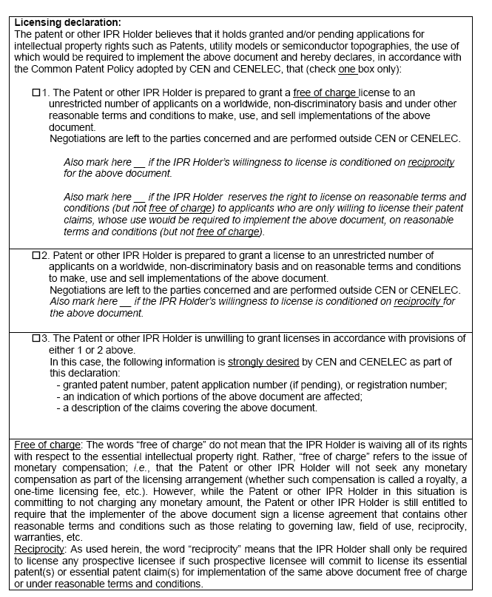
The declaration
Patent granted “free of charge”
Patent granted € at FRAND conditions
Patent not granted

Slide 9
CEN and CENELEC Patent policy
Patent Declaration
Patent list provided on the CEN and CENELEC websites
Commitment of the patent holders to license
Ability of design-around
Avoid patented technologies
Possibility to consider other technologies

Slide 10

EU Institutional/Regulatory framework
EU standardization legislation/rules
EU
(European Commission)
EU competition law
Patent offices
Natl/EPO
holder
“Essential” patent
CEN & CENELEC standardization process
Patent pool
agreements
Standard implementers
(FRAND)
*Source “Patents in standards: A modern framework for IPR-based standardization” © EC

Slide 11

CEN and CENELEC Patent policy
Collaborative approach in standards development
Patented technologies can be incorporated in standards
Balancing of interests

Slide 12
Practical implication of the patent declaration...
company A makes a product and needs to implement a standard
the standard contains an (essential) patented technology of company B
Company A needs a licence to use that patented technology
Thanks to the patent declaration, company B (and any successor) is committed to deliver the licence for free or by payment at FRAND conditions
Both parties negotiate the terms of the licence

Slide 13

Patent holder vs. Standard users ?
The risk of tensions between competing interests
Patent ambush
Patent shark/ trolling
Royalty stacking
Patent hold-up

Slide 14
Patent holder vs. Standard users ?
“Ambush”
Development standard phase:
company withholds information about its essential patent
Standard in the market:
company asserts that its patent is infringed by the use of the adopted standard
Deceptive & non-transparent conduct!
CEN-CENELEC Guide 8 strongly encourages all experts to disclose essential patents at the best of their knowledge

Slide 15
Patent holder vs. Standard users ?
“sharks / trolls”
Patent holder is not a member / not participating in TCs
Not obliged to respect CEN-CENELEC “FRAND” policy
Assert its patents rights after the standard is widely implemented by companies
Difficult scenario!
Patents of non members should be detected as early as possible > agreements can be made
CEN-CENELEC Guide 8: experts to disclose essential patents at the best of their knowledge

Slide 16
Patent holder vs. Standard users ?
“Royalty stacking”
Too many patents royalties to be paid in a standard
Multiple royalty burden may:
Be obstructive to the use of the standard
Have negative effect on the price of the downstream product in the market
Various solutions
Patent pooling, cross licensing…

Slide 17
Patent holder vs. Standard users ?
“Hold-up”
Patent holder demanding a higher royalty rate than he could have negotiated if the patent was not essential for the standard
What about FRAND conditions?
Many litigations...
Matter of perception:
What is reasonable for “A” may not be reasonable for “B”
Matter of timing:
What is a fair price today may not be a fair price tomorrow

Slide 18
CEN and CENELEC approach towards ADR
CEN and CENELEC ensure that there is transparency and completeness of information in their system
FRAND is a “comity device” designed to promote good faith negotiations
Determination of patent essentiality and licensing conditions is entrusted to the patent owners and licensees (neutrality)
ADR and judicial/administrative bodies are competent to decide on the relevant disputes and their resolution, taking into account specific interests and public policies

Slide 19

Patents: an issue for the future?
Trends
Standards and Research
Complexity of technologies & complexity of standards
Internet of Things (“IoT”)
Device-to-device communication (“D2D”)
New generations of interoperable products

Slide 20

Patents: an issue for the future?
Essential patents
Today:
  telecoms
  Object identification tech. (Wi-Fi)
  Computer consumer electronics
  Audio/video coding standards
Growing:
  automotive
  "smart" sectors
Soon:
  Internet of Things/M2M/D2D

Slide 21

Thank you!
Spiro Dhapi
Legal Affairs
Strategy and Governance
sdhapi@cencenelec.eu

