Slide 1
The EU Regulatory Framework and the Role of Small Business Standards
Riccardo Viaggi - SBS Board Member & EBC Secretary General
Standardisation for SMEs: sectoral representation at EU level
Madrid, 22 September 2016

Slide 2

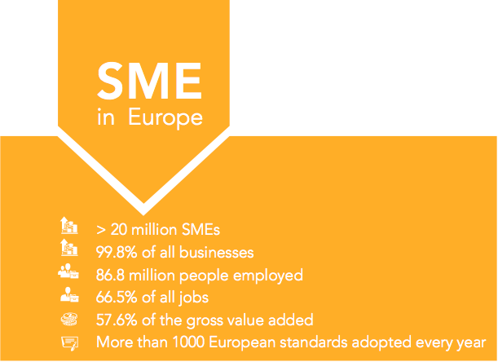

Economic importance of SMEs in Europe
Notes:
The majority of European standards developed by the three European Standardisation Organisations CEN, CENELEC and ETSI are developed outside the mandating scope of the European Commission. This way standards can be made by the industry and for the industry itself. This is an important point, as entrepreneurs know and understand when they might require a standard.
SMEs cover a wide scope of economic activities and are involved in almost every imaginable economic sector. Consequently, they are strongly affected by standards in their daily business.
According to the European Commission annual report on European SMEs 2013/2014, SMEs represent “99.8% of all enterprises in the non-financial business sector in 2013.” There are more than 20 million SMEs throughout Europe and they play an immensely important role in keeping Europe’s economy competitive and ensuring employment all over Europe with 86. 8 million people employed which represents 66.5% of all jobs. Economically, the contribute to 57.6% of the gross value added in 2013.
SMEs, however, are a very heterogeneous group of economic actors, represented in a wide array of sectors, and composed of “smaller players” in the area of standardisation. Given their importance as a whole, the European Commission has noted the fact that they need to be better involved in the European Standardisation System – which is where SBS comes into play.

Slide 3
Challenges and difficulties for SME participation in standardisation
Lack of knowledge of the standardisation process
Technical complexity
Underrepresentation in standardisation
Unaware of the benefits brought by standardisation
Notes:
Explain legal basis for SBS (EU Regulation 1025/2012)
4 Annex III organisations – organisations established by initiative of the European Commission to ensure better representation of “weaker” stakeholder groups. Annex III organisations eligible for EU funding.
SBS has the official mandate to represent SMEs in the European Standardisation System towards other stakeholders (SBS participating as observer in CEN, CENELEC BT and GA meetings, cooperating with them on SME issues – SBS is full member of ETSI)
SBS has currently 22 member organisations (18 organisations at the beginning). Eligibility for membership – national or European sectoral or cross-sectoral association representing SME interests. Access will be granted to EFTA and EU accessing countries (change of statutes).
SBS activities based on work programme with the EC.

Slide 4
Creation of Small Business Standards
Economic importance of SMEs in Europe
Difficulties encountered by SMEs in standardisation
Creation of Small Business Standards
Legal Framework: Regulation (EU) No 1025/2012

Slide 5
Small Business Standards in a nutshell
EU Regulation 1025/2012
Annex III Organisation
22 Member Organisations – 14 million SMEs
Mandate to represent SMEs in the ESS
Activities based on work programmes financed by the EC
Small Business Standards
Notes:
Explain legal basis for SBS (EU Regulation 1025/2012)
4 Annex III organisations – organisations established by initiative of the European Commission to ensure better representation of “weaker” stakeholder groups. Annex III organisations eligible for EU funding.
SBS has the official mandate to represent SMEs in the European Standardisation System towards other stakeholders (SBS participating as observer in CEN, CENELEC BT and GA meetings, cooperating with them on SME issues – SBS is full member of ETSI)
SBS has currently 22 member organisations (18 organisations at the beginning). Eligibility for membership – national or European sectoral or cross-sectoral association representing SME interests. Access will be granted to EFTA and EU accessing countries (change of statutes).
SBS activities based on work programme with the EC.

Slide 6
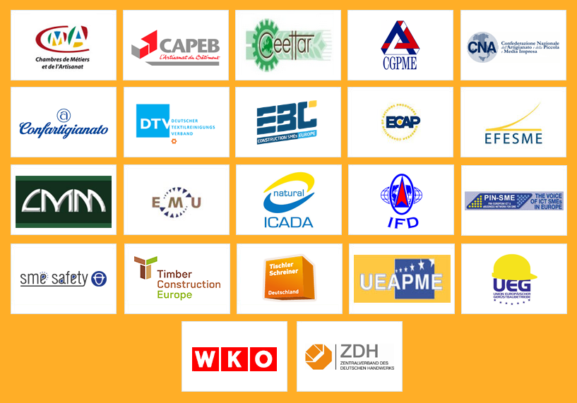

Slide 7
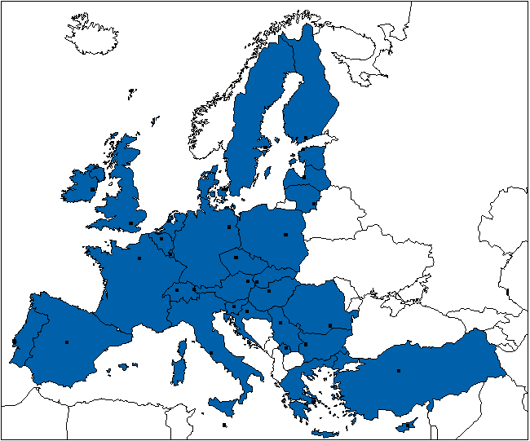

Slide 8
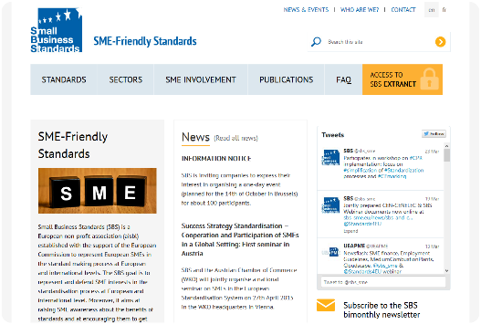
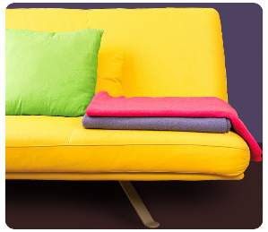
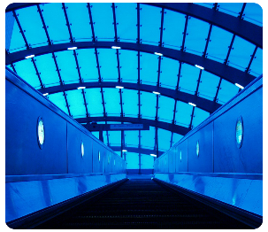
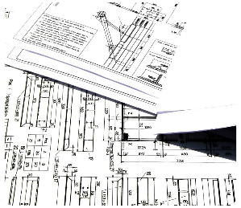
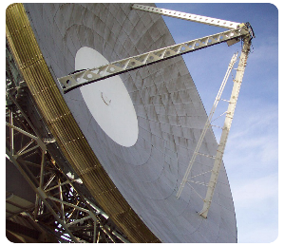
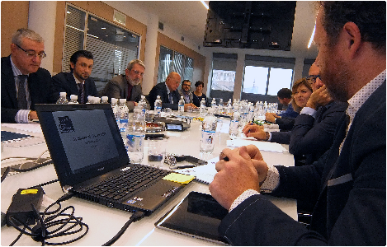
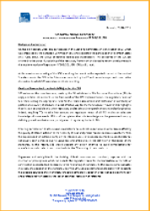
What is SBS doing?
Representing SME interests in the standardisation process
Technical
Political
TCs/WGs
Expert coordination
Technical news
Presence in ESOs managing bodies
Contribution to policy initiatives (JIS)
CoS and SME WG
Awareness raising & communication
Notes:
SBS – experts appointed to represent SME interests in technical committees of European Standardisation Organisations. SBS covers 19 different sectors including amongst others cosmetics, furniture, wood, textiles, construction, ICT, occupational health and safety, etc.
SBS organises 2 SBS expert training seminars per year.
Experts report on activities and developments in their respective TCs to SBS. They also set up SME mirror committees (similar to the national delegation principle at national level) in order to work together with SMEs and other experts and thus ensuring an SME inclusive position in their work.
SBS fundamental role is to represent SMEs in the European Standardisation System. Consequently, SBS does not only nominate experts to TCs but SBS also participates in BT and GA meetings of CEN, CENELEC and ETSI. Moreover, SBS cooperates together with the CEN-CENELEC Management Centre and national standardisation organisations within the framework of the SME working group.
One important task of SBS consists in awareness raising – raising awareness of SME needs as such as well as raising awareness amongst SMEs about the ESS and the possibilities to take part in the standards drafting process in order to contribute to SME friendly standards. Communication tools – newsletter, website, regular news updates, national seminars (this year Austria, Latvia, Italy, Switzerland and France)
SBS regularly launched consultation to its members on important standardisation matters in order to identify and consolidate one common SME position. By these means, SBS contributes to the EU policy and regulatory work on standardisation and SME policy.
SBS cooperates with national standardisation organisations and ESOs together in order to identify and promote best practices. This year SBS will work on reports related to the application of the CEN-CENELEC Guide 17 (a guide to ensure that SME interests are thoroughly taken into account in the standards drafting process), a norms-price gap analysis (i.e. different price levels for the same norm amongst different countries), and a mapping of SME organisations throughout Europe.

Slide 9
SBS Activities - technical
Representing SMEs in the ESS
SBS presence in TCs/WGs - ISO (9), IEC (1), CEN (37), CENELEC (1), ETSI (4)
Cosmetics, Lifts, Wood, Furniture, Construction, Machinery, Textiles & Footwear, Road Vehicles, Doors & Windows
Experts meetings
Insulation Material, Cultural Property, Electrical Installations, Occupational Health and Safety, Welding, Tourism, Pyrotechnic
Notes:
Explain legal basis for SBS (EU Regulation 1025/2012)
4 Annex III organisations – organisations established by initiative of the European Commission to ensure better representation of “weaker” stakeholder groups. Annex III organisations eligible for EU funding.
SBS has the official mandate to represent SMEs in the European Standardisation System towards other stakeholders (SBS participating as observer in CEN, CENELEC BT and GA meetings, cooperating with them on SME issues – SBS is full member of ETSI)
SBS has currently 22 member organisations (18 organisations at the beginning). Eligibility for membership – national or European sectoral or cross-sectoral association representing SME interests. Access will be granted to EFTA and EU accessing countries (change of statutes).
SBS activities based on work programme with the EC.

Slide 10
SBS Activities - political
Representing SMEs in the ESS
Representation in ESOs’ management bodies (CEN, CENELEC, ETSI)
Committee on Standards
Contribution to policy (Joint Initiative on Standardisation, position papers etc)
CEN-CENELEC SME Working Group
Notes:
Explain legal basis for SBS (EU Regulation 1025/2012)
4 Annex III organisations – organisations established by initiative of the European Commission to ensure better representation of “weaker” stakeholder groups. Annex III organisations eligible for EU funding.
SBS has the official mandate to represent SMEs in the European Standardisation System towards other stakeholders (SBS participating as observer in CEN, CENELEC BT and GA meetings, cooperating with them on SME issues – SBS is full member of ETSI)
SBS has currently 22 member organisations (18 organisations at the beginning). Eligibility for membership – national or European sectoral or cross-sectoral association representing SME interests. Access will be granted to EFTA and EU accessing countries (change of statutes).
SBS activities based on work programme with the EC.

Slide 11
SBS Activities – Awareness raising & communication
Representing SMEs in the ESS
General trainings (Training sessions, national seminars, Annual Conference)
Specific trainings with other sectors
Reports and analyses
Website, Twitter, newsletters etc
Notes:
Explain legal basis for SBS (EU Regulation 1025/2012)
4 Annex III organisations – organisations established by initiative of the European Commission to ensure better representation of “weaker” stakeholder groups. Annex III organisations eligible for EU funding.
SBS has the official mandate to represent SMEs in the European Standardisation System towards other stakeholders (SBS participating as observer in CEN, CENELEC BT and GA meetings, cooperating with them on SME issues – SBS is full member of ETSI)
SBS has currently 22 member organisations (18 organisations at the beginning). Eligibility for membership – national or European sectoral or cross-sectoral association representing SME interests. Access will be granted to EFTA and EU accessing countries (change of statutes).
SBS activities based on work programme with the EC.

Slide 12
Upcoming Activities
Representing SMEs in the ESS
On-going work at Technical Level
Political – Joint Initiative on Standardisation
Communication Tools: newsletter, website, twitter
Trainings (General and Specific)
Notes:
Explain legal basis for SBS (EU Regulation 1025/2012)
4 Annex III organisations – organisations established by initiative of the European Commission to ensure better representation of “weaker” stakeholder groups. Annex III organisations eligible for EU funding.
SBS has the official mandate to represent SMEs in the European Standardisation System towards other stakeholders (SBS participating as observer in CEN, CENELEC BT and GA meetings, cooperating with them on SME issues – SBS is full member of ETSI)
SBS has currently 22 member organisations (18 organisations at the beginning). Eligibility for membership – national or European sectoral or cross-sectoral association representing SME interests. Access will be granted to EFTA and EU accessing countries (change of statutes).
SBS activities based on work programme with the EC. European standardisation system, national seminars, Annual Conference) Specific Trainings including with other sectors

Slide 13



Thank you for your attention
Rue Jacques de Lalaingstraat 4
B-1040 Brussels, Belgium
www.sbs-sme.eu
info@sbs-sme.eu
Financed by the European Commission and EFTA

