Slide 1
“ADR – a potential tool for SMEs for standards related disputes”
Christian Loyau
SBS
22 January 2019
The views expressed are personal to the speaker and do not necessarily represent those of ETSI

Slide 2
Agenda
Presentation of ETSI
The irrevocable undertaking of Art 6.1 of the ETSI IPR policy
Should transparency not start with more accuracy ?
ETSI and FRAND
Standardizations, patenting, licensing and disputes are global – court decisions are national

Slide 3
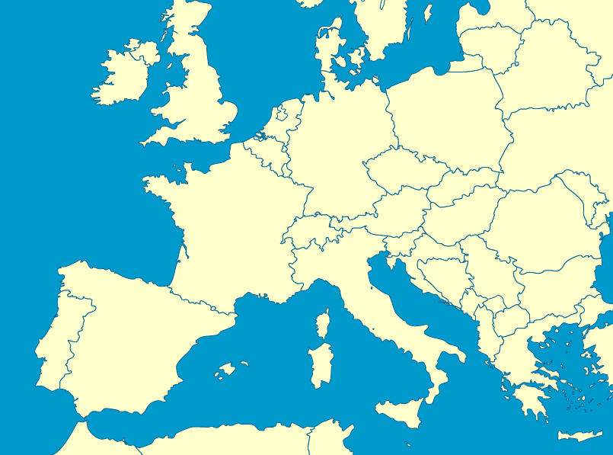
ETSI
ETSI is a French non profit organization located in Sophia Antipolis
Produces standards in support of European Union policies and legislation, e.g.
Radio
e-ID
e Signatures
Security
Accessibility
It contributes to ICT radio frequency requirements to the European co-ordination process
EC and EFTA are Counsellors of ETSI

Slide 4
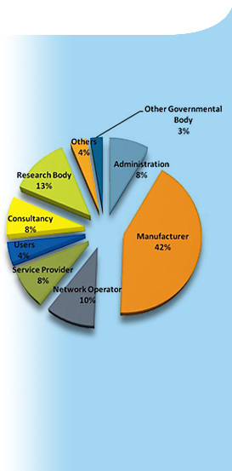
Membership
Over 850 companies, big and small, from 68 countries on 5 continents
Manufacturers, network operators, service and content providers, national administrations, ministries, universities, research bodies, consultancies, user organizations

Slide 5









ETSI Governance
GENERAL ASSEMBLY
Finance
Committee
IPR Special
Committee
BOARD
OCG
Intellectual Property Rights
Operation Co-ordination Group
At all levels, consensus is the preferred way
Technical Committees
Special Committees
Partnership Projects
Industry Specification Groups
Projects
EMTEL, SAGE,
User Group
3GPP, oneM2M

Slide 6
ETSI CEN CENELEC
3 European Standardization Organizations (I)
3 Standardization Development Organizations recognized by the EC :Regulation (EU) No 1025/2012 called European Standardization Organizations ESO
ETSI : responsible for producing globally-applicable standards for information and communications technology (ICT) including fixed, mobile, radio, converged, broadcast, and internet technologies.
CEN : responsible for producing standards for various types of products, materials, services, and processes including air and space, chemicals, construction and more.
CENELEC : responsible for producing standards in the electro-technical engineering field.

Slide 7
ETSI CEN CENELEC
3 European Standardization Organizations (II)
A harmonized standard is a European standard developed by a recognized European Standards Organization: CEN, CENELEC, or ETSI.
It is created following a request from the European Commission to one of these organizations.
Manufacturers, other economic operators, or conformity assessment bodies can use harmonized standards to demonstrate that products, services, or processes comply with relevant EU legislation.
The use of these standards remains voluntary.
Manufacturers, other economic operators, or conformity assessment bodies are free to choose another technical solution to demonstrate compliance with the mandatory legal requirements

Slide 8













ETSI
Vienna, 1991
(>30%)
Frankfurt, 2016
(>75%)
Industry (80%)
Public sector, users, R&D… (20%)
National standards bodies
Businesses, Industry federations
Extra EU +/- 30%

Slide 9
The irrevocable undertaking of Art 6.1 of the ETSI IPR policy

Slide 10
The irrevocable undertaking of Art 6.1 of the ETSI IPR policy
French non profit organisation : law of 1st July 1901 “relative au contrat d’association”
Art 1 : contract between 2 or several persons who agree to put in common on a permanent basis their knowledge or activities for another purpose than sharing benefits
All members are bound by contract and shall abide to the Directives including Annex 6
Art 12 of ETSI IPR Policy : “The POLICY shall be governed by the laws of France…”

Slide 11
The irrevocable undertaking of Art 6.1 of the ETSI IPR policy
Article 1205 of the civil Code :
“A person may make a stipulation for another person
One of the parties to a contract (the ‘stipulator’) may require a promise from the other party (the ‘promisor’) to accomplish an act of performance for the benefit of a third party (the ‘beneficiary’). The third party may be a future person but must be exactly identified or must be able to be determined at the time of the performance of the promise.”
On peut stipuler pour autrui.
L'un des contractants, le stipulant, peut faire promettre à l'autre, le promettant, d'accomplir une prestation au profit d'un tiers, le bénéficiaire. Ce dernier peut être une personne future mais doit être précisément désigné ou pouvoir être déterminé lors de l'exécution de la promesse.

Slide 12
The irrevocable undertaking of Art 6.1 of the ETSI IPR policy
Art 1205 of the civil Code : commitment to a performance or a contract ?
Patent license agreement under French law considered as a rental contract
And implies agreement on 3 substantial elements; the object of the contract, the duration, and the price;
High court judgment of June 1973 ( Cass.civ, 3ème, 27 june 1973 n° 72-12321) : a rental promise can only be considered as a rental contract if price is agreed
Art L. 613-8, IP Code : written agreement
Civil law ? – IP law ? – Competion law ?

Slide 13
Should transparency not start with more accuracy ?

Slide 14
COMMUNICATION FROM THE COMMISSION of 29.11.2017 ON TRANSPARENCY
“The Commission:
calls on SDOs to urgently ensure that their databases comply with the main quality features described above and will co-operate with SDOs to facilitate this process;
calls on SDOs to transform the current declaration system into a tool providing more up-to-date and precise information on SEPs and will co-operate with SDOs in order to facilitate that process;
considers that declared SEPs should be subject to reliable scrutiny of their essentiality for a standard, and will launch a pilot project for SEPs in selected technologies with a view to facilitating the introduction of an appropriate scrutiny mechanism.”

Slide 15
Definition of IPRs and disclosure (extract from the IPR policy)
"IPR" shall mean any intellectual property right conferred by statute law including applications therefor other than trademarks. For the avoidance of doubt rights relating to get up, confidential information, trade secrets or the like are excluded from the definition of IPR.
Disclosure of IPRs
4.1 Subject to Clause 4.2 below, each MEMBER shall use its reasonable endeavours, in particular during the development of a STANDARD or TECHNICAL SPECIFICATION where it participates, to inform ETSI of ESSENTIAL IPRs in a timely fashion. In particular, a MEMBER submitting a technical proposal for a STANDARD or TECHNICAL SPECIFICATION shall, on a bona fide basis, draw the attention of ETSI to any of that MEMBER's IPR which might be ESSENTIAL if that proposal is adopted.
4.2 The obligations pursuant to Clause 4.1 above do however not imply any obligation on MEMBERS to conduct IPR searches.
4.3 The obligations pursuant to Clause 4.1 above are deemed to be fulfilled in respect of all existing and future members of a PATENT FAMILY if ETSI has been informed of a member of this PATENT FAMILY in a timely fashion. Information on other members of this PATENT FAMILY, if any, may be voluntarily provided

Slide 16
Current Status of the ETSI IPR database (I)
Distribution of declarations/patent families over time (absolute and aggregate)
 | 2011 | 2012 | 2013 | 2014 | 2015 | 2016 | 2017
Number of declarations | 141 | 145 | 181 | 199 | 142 | 136 | 244
Number of Patent Families | 2620 | 2687 | 2125 | 2399 | 2033 | 2088 | 5578
Distribution of patent families over projects
 | 2011 | 2012 | 2013 | 2014 | 2015 | 2016 | 2017
Number of patent families | 2652 | 2874 | 2145 | 2622 | 2323 | 2088 | 5578
Number of projects | 132 | 163 | 75 | 81 | 59 | 58 | 74

Slide 17
Current Status of the ETSI IPR database (II)
Number of ISLD Declarations and disclosures where the couple patent number,
standard number is complete
 | Declarations | Disclosures
Total | 1168 | 28207
Complete (filter applied) |  | 27502
Rate |  | 97 %
Number of ISLD Declarations where the patent number, standard number is complete and at least one reference is provided in the field “Illustrative specific part”
 | Declarations | Disclosures
Total | 1168 | 28207
Complete (filter applied) |  | 7553
Rate |  | 26 %

Slide 18
ETSI & FRAND

Slide 19
COMMUNICATION FROM THE COMMISSION of 29.11.2017 ON GENERAL PRINCIPLES FOR FRAND LICENSING TERMS FOR SEPS
“…The Commission calls on SDOs and SEP holders to develop effective solutions to facilitate the licensing of a large number of implementers in the IoT environment (especially SMEs), via patent pools or other licensing platforms, while offering sufficient transparency and predictability…”

Slide 20
Fair Reasonable And Non Discriminatory
Patent protection & open standardization serve innovation but can be conflicting
No priority can be given to any of the principles of either system
Therefore SDOs should be eager to maintain the balance
Freedom to contribute by the members + FRAND license commitment => business neutrality of the SDO
No involvement of ETSI in commercial discussions between members => no contractual definition of FRAND
FRAND purpose : make innovation open and attractive
Courts begin to define FRAND but no harmonized decisions

Slide 21
Patent pools
Agreement between two or more patent owners to license one or more of their patents to one another or to third parties
Positive effects on competition and innovation. By sharing IPRs /SEPs, patent owners may develop new products and reduce their transaction costs and give easier access to implementers.
Negative effects cartel risk ; patent pools may provide an opportunity for a possible anti-competitive behavior: like any cooperation among competitors, they involve an inherent risk of collusive behavior.
From an SDO prospective ;essentiality check is done by the paten pool
From an implementer prospective ; single license contract for a bundle of patents “one-stop shopping”
From a patent owner prospective ; cost reducing effect and higher transparency

Slide 22
Standardizations, patenting, licensing and disputes are global – court decisions are national

Slide 23
COMMUNICATION FROM THE COMMISSION of 29.11.2017
“3.4. ALTERNATIVE DISPUTE RESOLUTION
The Commission takes the view that alternative dispute resolution (ADR) mechanisms such as mediation and arbitration can offer swifter and less costly dispute resolution. While there can be no obligation for parties to use ADR, the Commission believes that the potential benefits of this tool are currently underexploited.
Recourse to ADR is often hampered by unpredictability and criticised for lack of transparency of previous decisions. The success of such mechanisms depends not only on appropriate procedures, but also on the quality of experts. When it enters into operation, the Unified Patent Court should provide a dedicated arbitration and mediation centre benefitting from a pool of specialised judges, thus ensuring high quality and efficient proceedings, coherent practice and limited scope for forum shopping. As announced in its November 2016 strategy on IP for SMEs, the Commission is, together with the EUIPO, mapping IP mediation and arbitration tools with the view to facilitating the further roll-out of IP mediation and arbitration services, for SMEs in particular.
The Commission considers that the outcomes of disputes should also be included in SDOs' databases as mentioned in the chapter on transparency.”

Slide 24
TRIAL
ADR
  Forum shopping
Mediation
Patent owner
Self declaring SEPs to ETSI => irrevocable
commitment to FRAND licensing
  Senior executive to be present
Arbitration
Injunctive relief/
Damages
  Full disclosure of evidence to the parties
Single proceeding with determined law/Intl.
Successful negotiations =>
FRAND agreement
SEPs portfolio available for license to practice the standard
Dispute about SEPs portfolio and/or its value and/or FRAND T&Cs
Expertise of arbitrators + Experts
Possibility to seek court ordered injunction
  Appeal
Portfolio/
Validity/
Essentiality
of SEPs ?
Implementer
Inter partes decision about validity and/or of SEPs
Limited appeal =>
quick result
  Duration
Final and enforceable decision
(New York convention)
Proceedings & award confidential

Slide 25
ADR
Arbitration = one of the techniques of « ADR »
others are e.g. Mediation, Conciliation (unilateral mediation request), Expert Determination
«Dispute escalation clauses» : first negotiation, then mediation/conciliation, then litigation (arbitration or courts)
What can be arbitrated
T&Cs of FRAND offers/counter offers
Essentiality of patents
Validity of patents if inter partes agreement
Scope of a portfolio

Slide 26
Different options chosen by Courts
Patent vs Patent portfolio
Single rate vs. range of rates
Top-down approach (determination of the aggregate royalty that should be paid for all SEPs covering a particular standard, and then allocation of an appropriate portion of the total to the asserted SEPs) vs. bottom-up approach (assess the value of asserted SEPs in isolation by using comparable license agreements)
Royalty base (Entire Market Value Rule V. Smallest Salable Patent Practicing Unit )
Patent counting vs. individual valuation
Ex ante (SEP royalties should only reflect the value before the standard is widely adopted in the market) vs. ex post
TCL v Ericsson – Unwired Planet v Huawei

Slide 27
Thank you for your attention
Christian Loyau
christian.loyau@etsi.org
M:+33(0)698692042

